Slide 1

SPACE WEARABLES

Slide 2
Challenge
design wearable clothing and accessories that could be useful for the engineers, technicians, and scientists involved with ground processing spacecraft and rockets and/or researchers, both on and off world, doing lab or field work
Prototype hardware if possible.

Slide 3
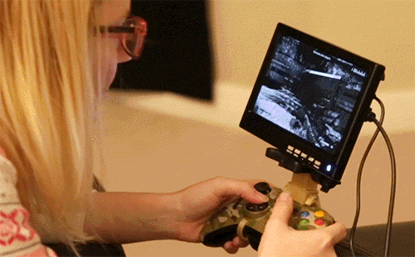
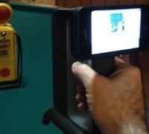
How
Astronauts are extremely busy and always under pressure. 3D printing display mounts that can attach to them and keep up with their movements would greatly increase their mobility.

Slide 4
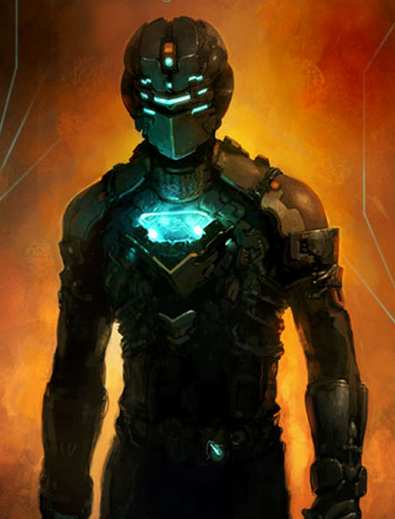
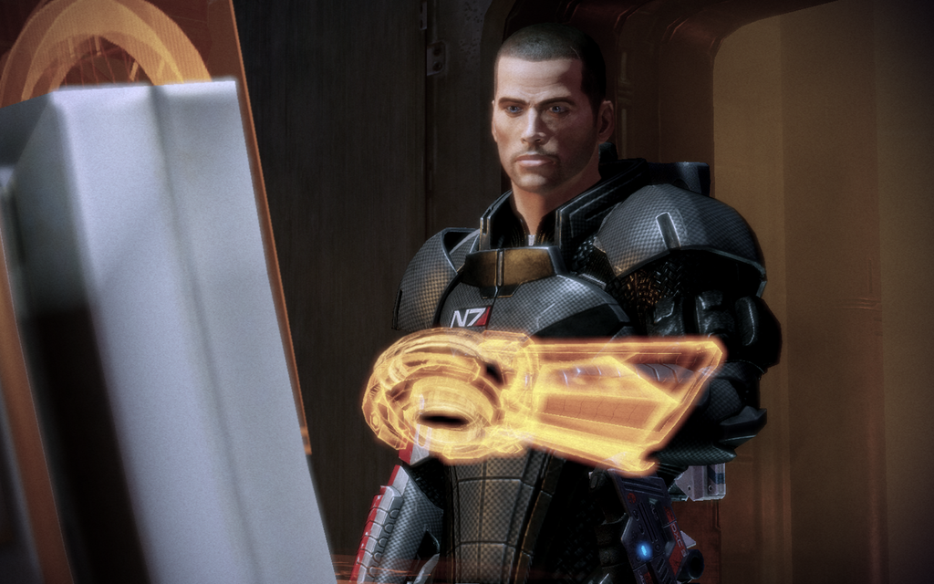
WHY
The flexibility of 3d printer gives astronauts another dimension to think in.
Every time you have that moment that you think “if only i could just” or “it I just had something to hold this” now you can.

Slide 5
Focus has changed due to research.
research has shown that nasa has reached a limit on physical wearable real estate, and so an “attachment system” didn’t seem like the most effective use of suit real estate. As we researched we found much more pressing issues for the EVA suit. Such as field of vision limitations, communication troubles do to the limits of their current coms systems and information delivery.

